Slide 1
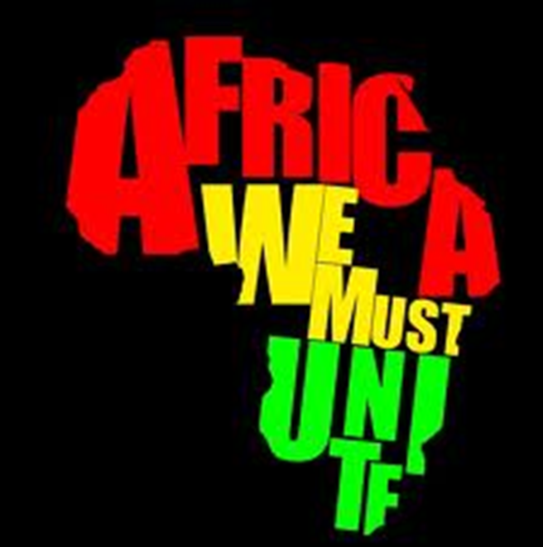
African History Vocabulary: Nationalism

Slide 2
Pan-African Movement
movement which began in the 1920's that emphasized the unity and strength of Africans on the main continent and people of African descent around the world.
팬 아프리카 이동 Movimento Pan-Africano
泛非运动 جنبش پان آفریقایی
Pan African Movement Movimiento Panafricano

Slide 3
African National Congress (ANC)
Formed by black Africans, in 1912 to fight for their rights. They organized strikes and boyotts to protest racist policies. Nelson Mandela was a leader in this organization.
El Congreso Nacional Africano (ANC)
Congresso Nacional Africano (ANC)
Congrès national africain (ANC)
南非非洲人国民大会（非国大）
아프리카 민족 회의 (ANC)
کنگره ملی آفریقا (ANC)

Slide 4
Great Britain and France
The two European Countries that
dominated African colonization.
영국과 프랑스 بریتانیا و فرانسه
Gran Bretaña y Francia 英国和法国
Grã-Bretanha e França
La Grande-Bretagne et la France

Slide 5
Nationalism
a strong sense of pride in one's nation, so
much so, that you want self rule.
Nationalisme 민족주의
Nacionalismo ناسیونالیسم
民族主义情绪 Nacionalismo

Slide 6
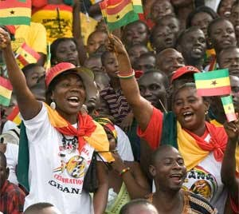
Independence Movement
Actions taken to be free from
foreign control.
Movimento de independência
독립 운동
جنبش استقلال
独立运动
Mouvement de l'Indépendance
Movimiento de Independencia

Slide 7
Diaspora
Geographic spreading of
Africans around the world.
散居 Diaspora
خارج از کشور 유대인의 분산
Diaspora Diáspora

Slide 8
Civil War
Fighting within a county.
جنگ داخلی
내전
Guerra civil
内战
Guerre civile

