Slide 1
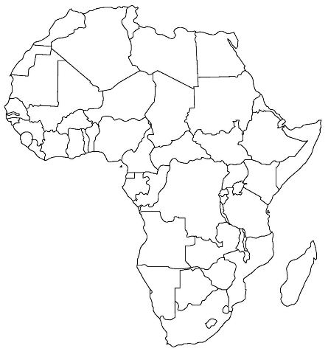
Review Topic = African countries
1
4
3
7
2
5
Number #1-7.
Write the correct name of each country labeled here.
6

Slide 2
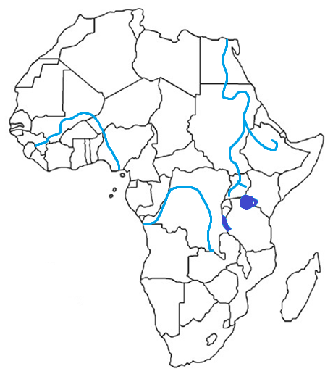
Warm-Up Topic = Africa’s Physical Features
2
1
4
3
6
7
Number #1-8.
Write the correct name of each feature labeled here.
8
5

Slide 3
Warm-Up Topic = African Climate Zones
2
1
3
Number #1-4.
Write the correct name of each climate zone labeled here.
4

Slide 4
Warm-Up Topic = Water Scarcity
Take out your Africa folder and brochure.
On your Warm-Up sheet…
1) Fill in the date
2) Fill in the topic
3) In your own words, explain what water scarcity means.

Slide 5
Warm-Up Topic = Deforestation
Take out your Africa folder and brochure.
On your Warm-Up sheet…
1) Fill in the date
2) Fill in the topic
3) In your own words, explain what deforestation is.

Slide 6
Warm-Up Topic = Desertification
Take out your Africa folder and brochure.
On your Warm-Up sheet…
1) Fill in the date
2) Fill in the topic
3) In your own words, explain what desertification is.

Slide 7
Topic = Religious groups
WARM-UP
Answer on your Warm-Up sheet.
Which 2 African ethnic groups practice Islam?
What is animism?
Which ethnic group is Bantu + Arab?
Everyone, take out your Africa folder
Collectors, pass back papers
H-Monitors, nothing
A-Managers, anyone absent?
Supply Managers, baskets
Retrievers, 1 paper
O-Managers, tickets

Slide 8
Topic = Ethnic groups
WARM-UP
List one thing you remember about…
The Arabs
The Ashanti
The Bantu
The Swahili
Everyone needs a piece of notebook paper
HW monitors, nothing
Collectors, test nooks
A-Managers, anyone absent?
Supply Managers, baskets
Retrievers, remotes
O-Managers, you know!

Slide 9
When you are done with your Test…
Turn your test and answers in to the red pockets (on the side of the room).
Put your remote up front.
Put your Test Nook back by the file cabinet.
Pick up an “Endangered Species” crossword puzzle and work on it silently at your desk.
If you do not finish your crossword, it becomes your homework.

Slide 10
After your test…
Remotes, scantrons, & test copies to the front.
2) Test nooks to the back.
3) If you need to finish typing your
rough drafts, ask Ms. Mac
for a laptop.
4) If you finished typing yesterday,
find make-up work in your
bookbag/binder OR do
something SILENTLY!

