Slide 1
Fall of the Ottoman Empire and Conflict in SW Asia

Slide 2
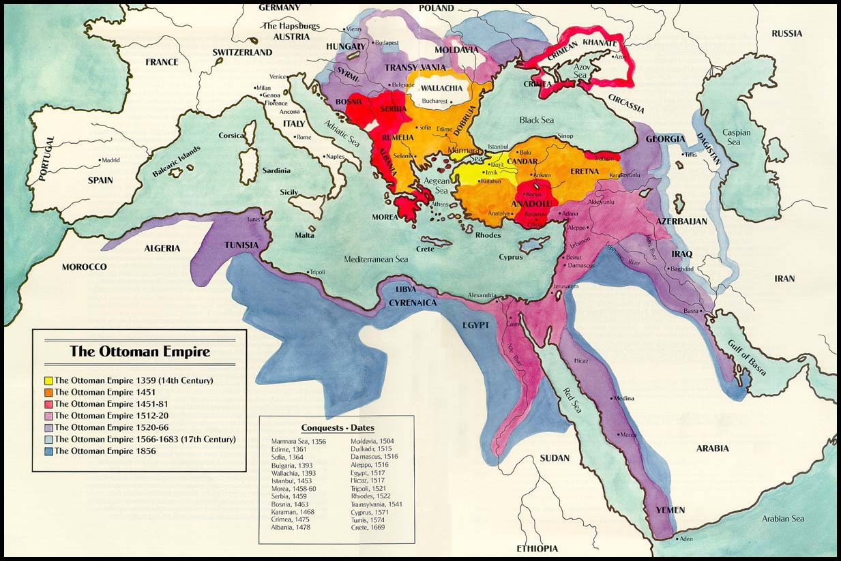
Ottoman Empire’s Lands

Slide 3
Reasons for the Decline of an Empire
Ottomans’ technology begin to fall behind
Europe
When the Ottoman Empire reached it’s height, other empires attack the Ottomans and/or conflict arises within the Empire
Fighting causes the Empire to lose land

Slide 4
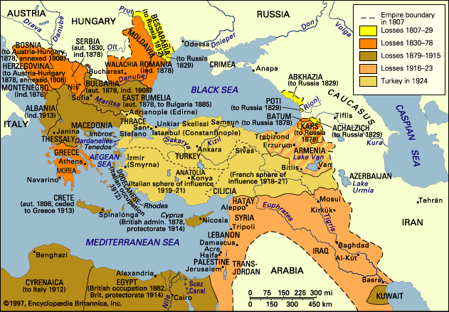
Map of Lost Ottoman Land

Slide 5
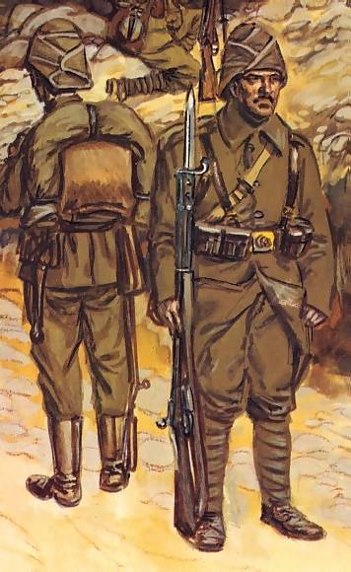
Ottoman Empire & WWI
What’s left of the Ottoman Empire enters WWI (1914-1918) on Austrian-Hungarian Empire & Germany’s side (Central Powers)
motive was to regain some of the land they lost.
In 1916, France and UK agreed on how to divide up the Ottoman Empire if their side (Allied Powers) won the war: known as Sykes-Picot Agreement.

Slide 6
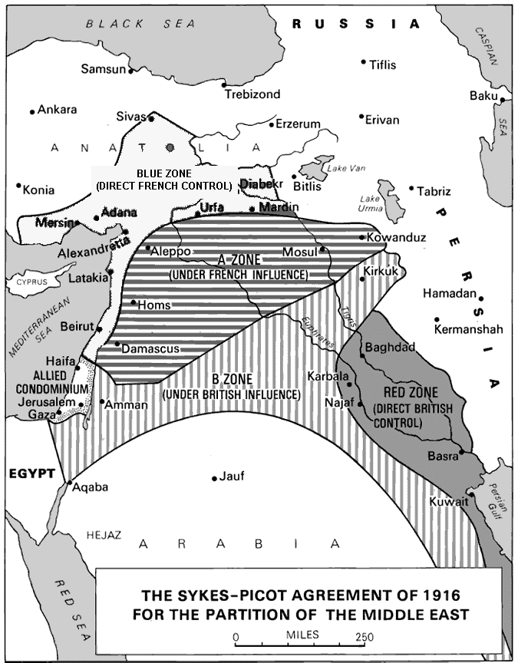
Sykes-Picot Agreement, 1916

Slide 7
Results of WWI & Partitioning
When the Ottomans and the rest of the Central Powers lost…
The Sultanate (1922) and the Caliphate (1924) ended
Republic of Turkey was created out of the Ottoman Empire 1923
All the land that was under the control of the Ottoman’s was given to France and UK as a mandate
British and French partitioned (divided) the Middle East in to countries;
THIS CREATES ARTIFICIAL POLITICAL BORDERS
DID NOT NECESSARILY REFLECT THE NATURAL DIVISIONS IN THE REGION – BLENDED GROUPS

Slide 8
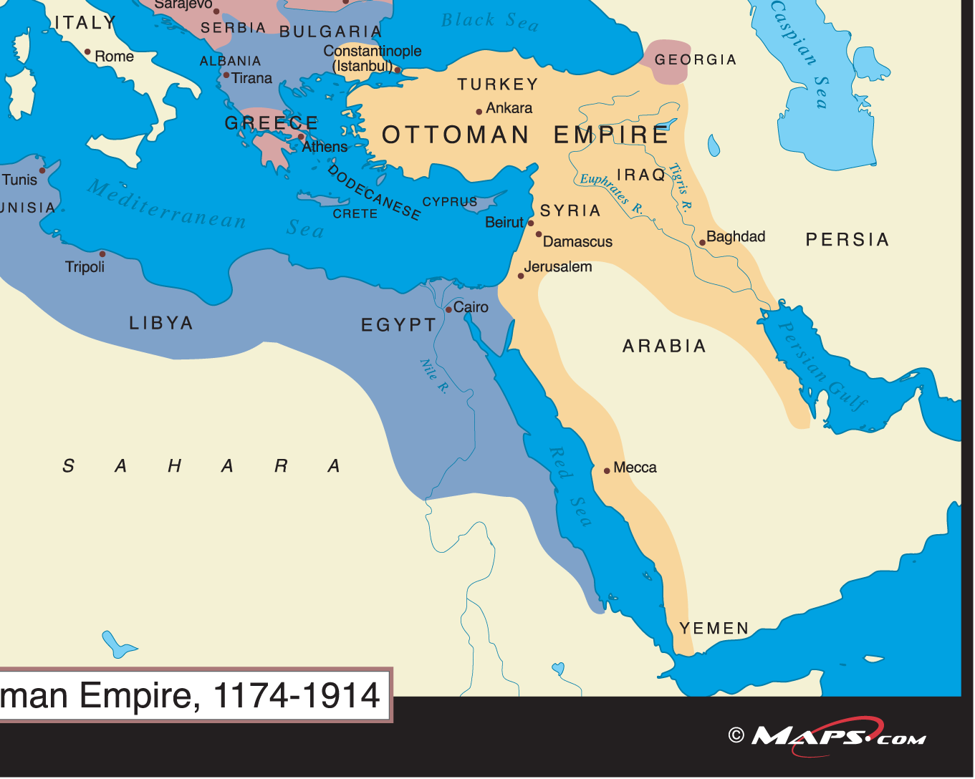
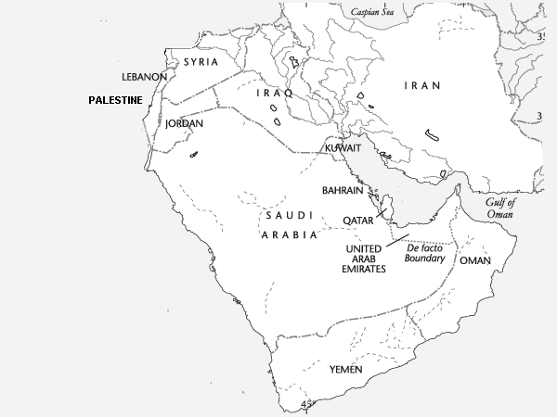
After WWI, Britain and France redraw the borders of the Arab lands, creating new countries that they control.
Many ethnic and cultural groups are
split up by the new artificial boundaries.

