Slide 1
The Atomic Bombs, the End of WW2, and the Rebuilding of Japan

Slide 2
Hiroshima & Nagasaki The Atomic Bombs that ended WWII…

Slide 3
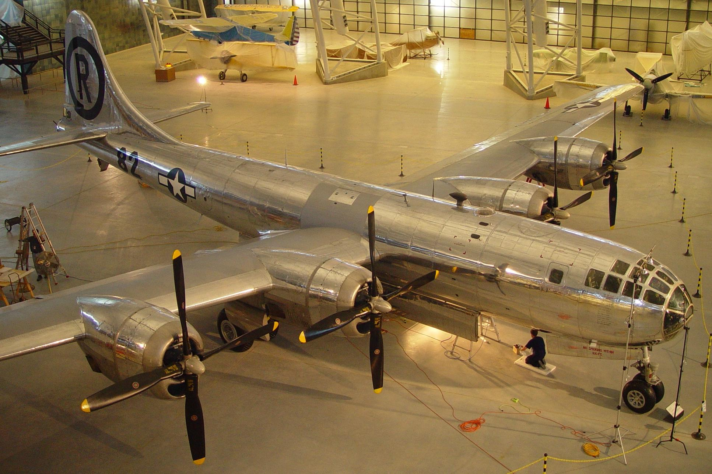
Superfortress ENOLA GAY

Slide 4
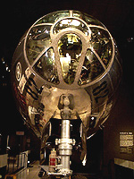
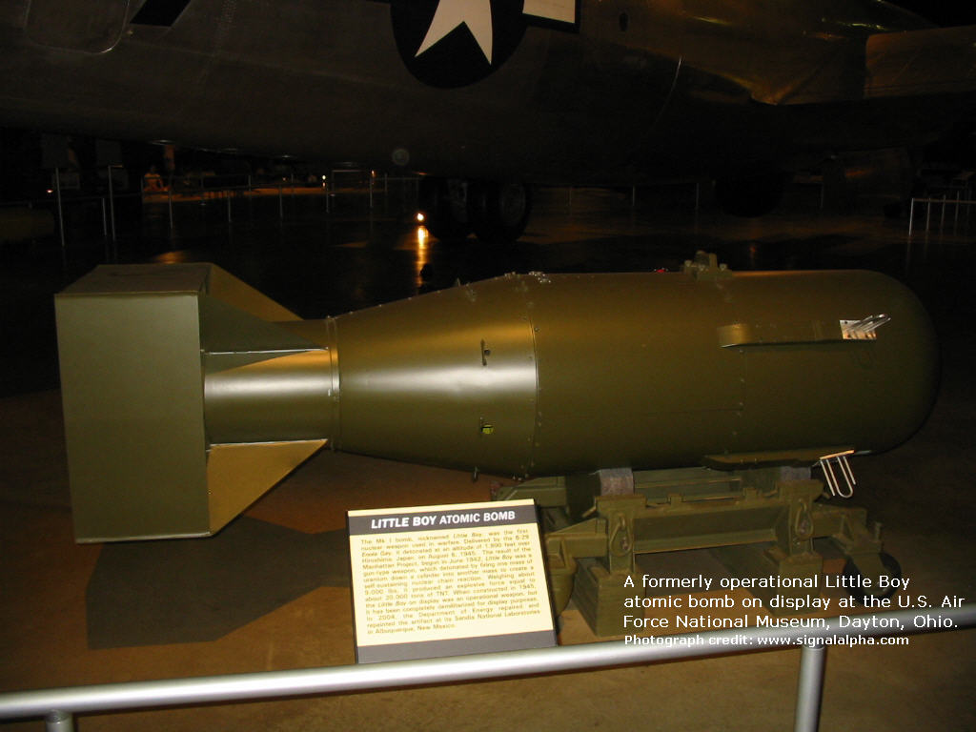
The Enola Gay
And Little Boy Atomic Bomb

Slide 5
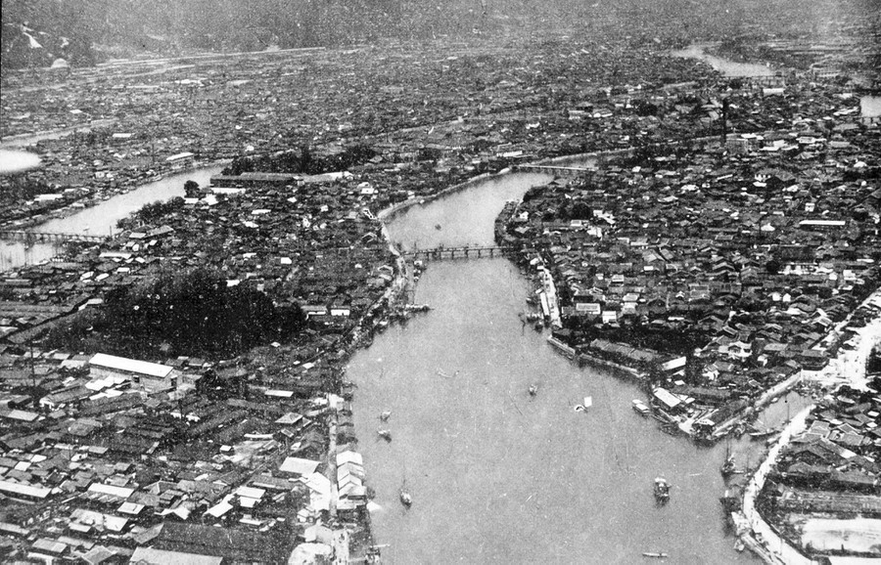
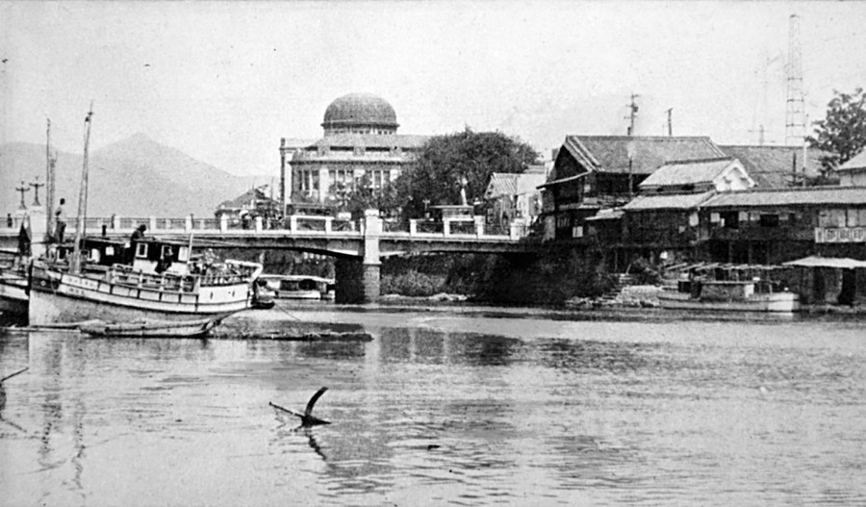
Hiroshima
The morning of
August 6th, 1945
A day of passing clouds and warm temperatures.
Japanese people seeing a single silver plane ignored the warning sirens...they had been safe from the firebombing in other cities.
In seconds their world was changed forever…

Slide 6
WATCH A VIDEO ON THE EVENTS OF THAT DAY

Slide 7
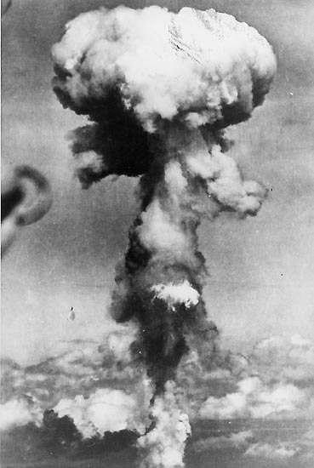
Hiroshima
8:15 am August 6th, 1945
'Now I am become Death, the destroyer of worlds” – quoted from Hindu scripture by …
Dr. Robert Openheimer, Mathattan Project.
The “Mushroom” as seen from the rear of the B-29 “Great Artiste” the camera plane.
https://www.youtube.com/watc

Slide 8
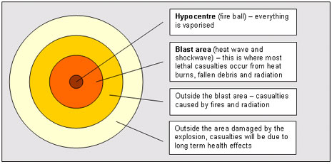
Hiroshima blast area
Up to 2 miles in diameter

Slide 9
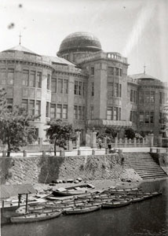
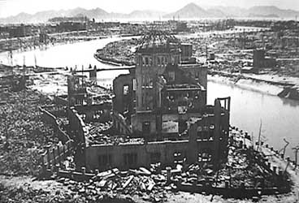
Before and After

Slide 10
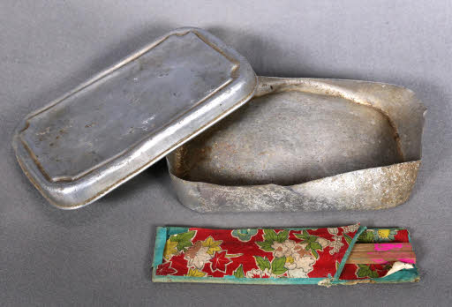
One young High School student named Yoko Mariwaki was among those working in the streets to clear debris with her classmates…her diary tells about her pride in her country and was written with emotion and insight right up until the night before…
“my legs were quite sore after today’s labor service, but who cares about that compared to what our soldiers are going through…”
Yoko died of her injuries and radiation sickness
in less than 12 hours after the explosion. She
called out “Okassa–Mother”. Her mother was unable to get to her from the shrine island they lived on in the bay.
Yoko’s brother donated
her school blouse and
battered lunch tin that
were found in the rubble near where she and
her classmates had been working that day.

Slide 11
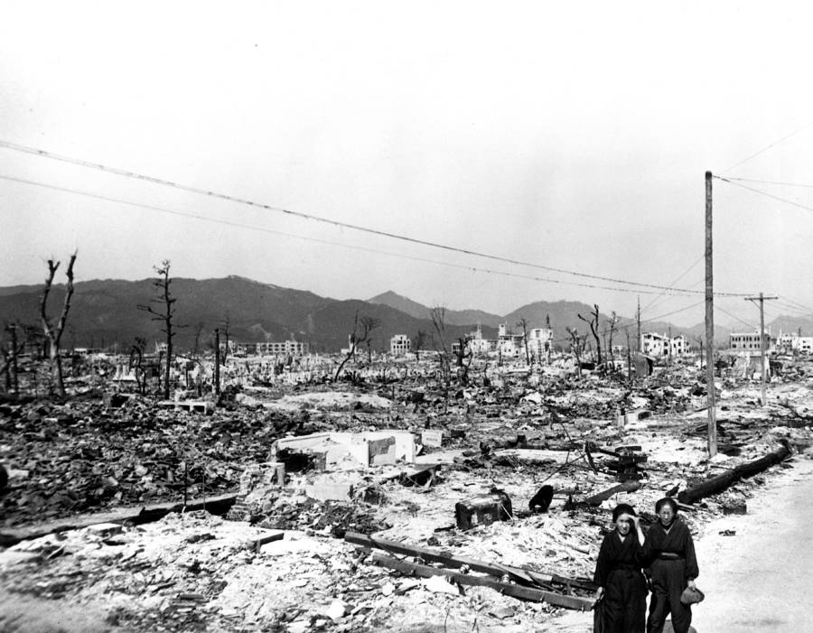
Most Japanese dwellings were made of wood. The firestorm the bomb produced spread devastation 3 miles in every direction.

Slide 12
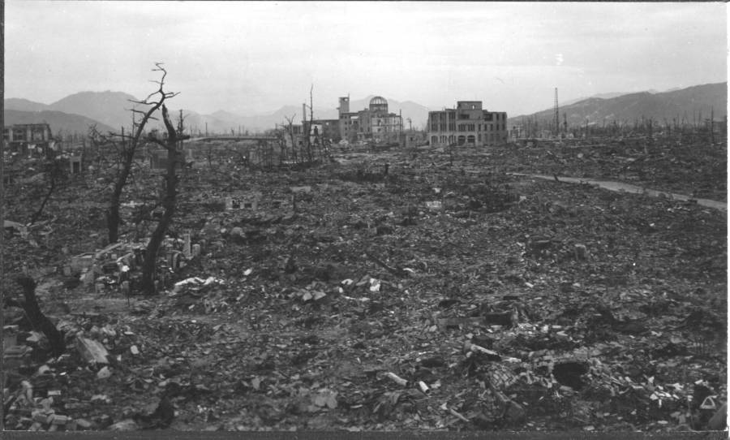

Slide 13
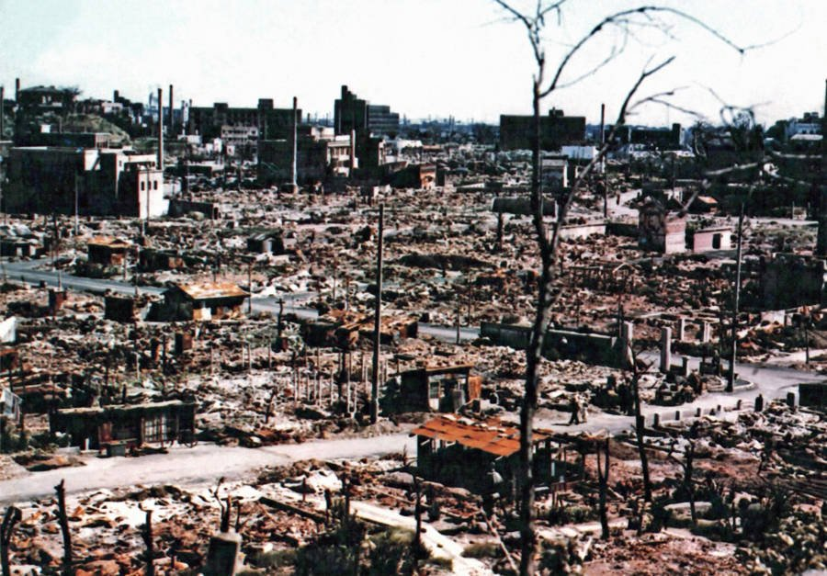

Slide 14
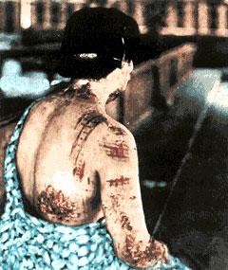
Clothing that protects, was the cause of injury. The lady’s dark Kimono was pattern-burned into her skin.
White was the best to wear in the “Flash”, while black absorbed all light, severely
harming those who wore it.

Slide 15
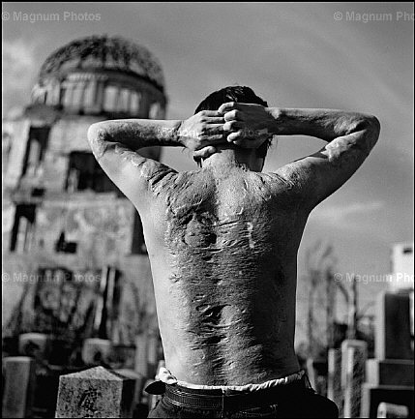
Burns and Injuries lead to scar tissue and a lifetime of treatment.
Victims were ashamed of having survived.

Slide 16
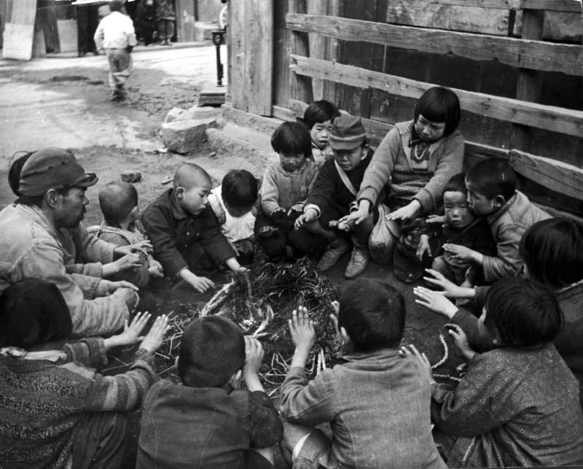
U.S. Occupying Troops with General Douglas MacArthur
arrived August 15th and found destroyed cities and starving,
frightened people. Soldiers shared what they had…
Senator from Oregon, Mark Hatfield (rep), recalls…”there was a smell to the city and total silence…We sailed up the canals…when we landed, little kids saw we weren’t going to shoot them and gathered around us. We broke up our lunches and gave them to as many kids as we could.”

Slide 17
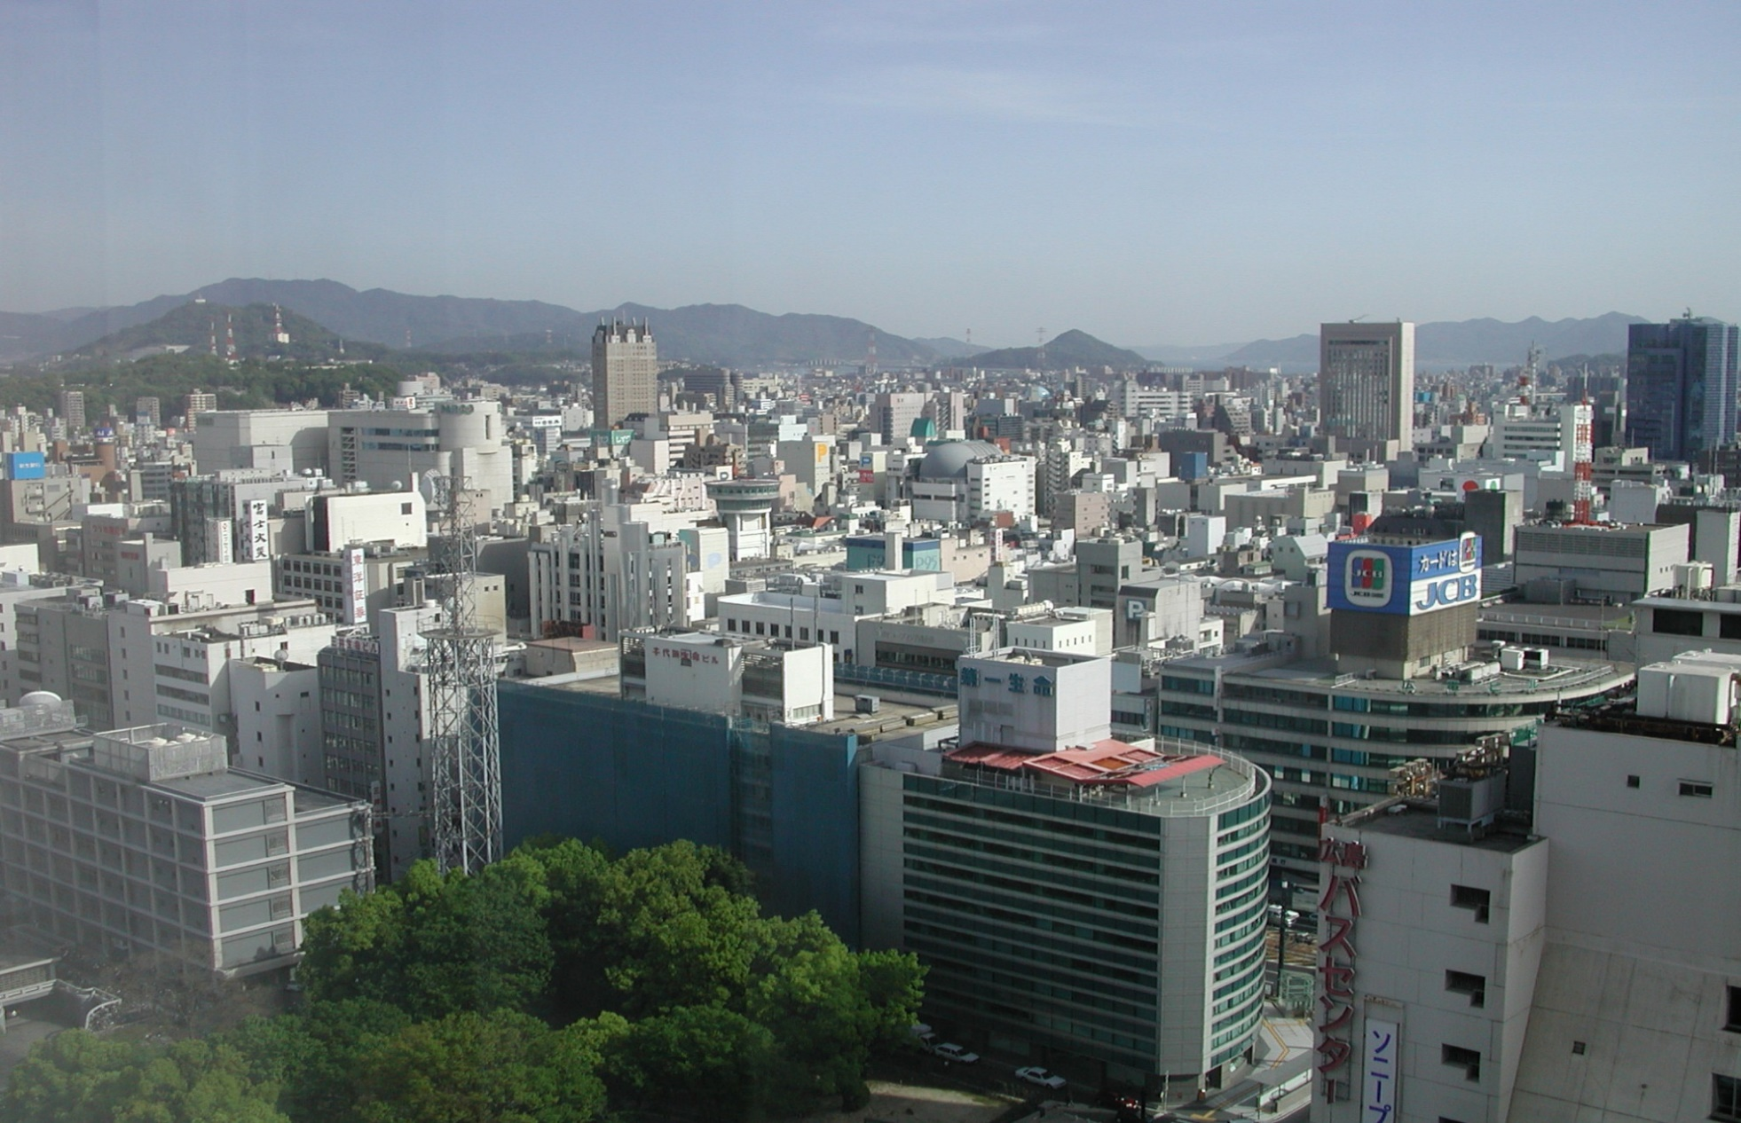
Hiroshima Today

Slide 18
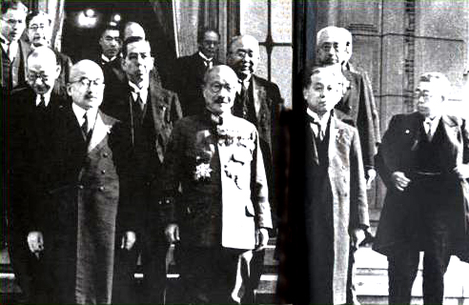
Despite mass destruction of the Hiroshima and more than 100,000 dead or missing, the Imperial Military staff refused to surrender and only offered silence.
President Harry Truman announce that Japan would receive a “rain of ruin from the air.” America got ready for a second mission from Tinian.

Slide 19
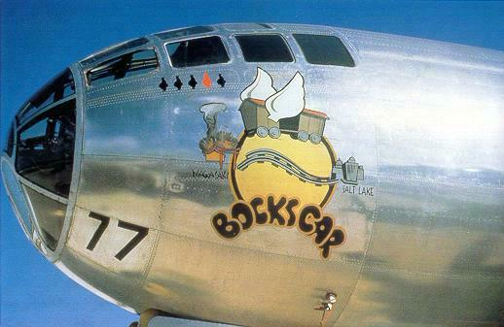
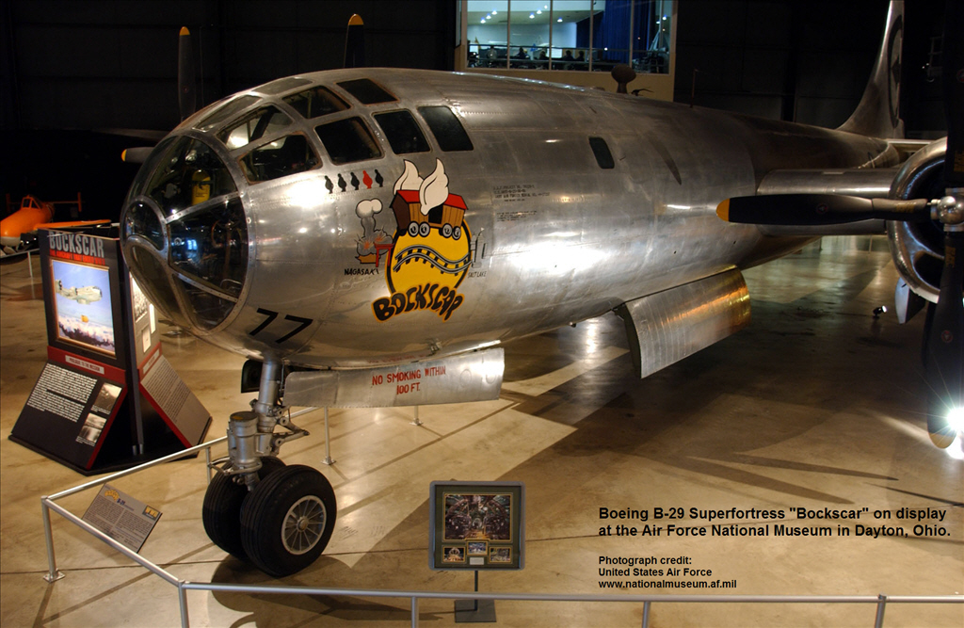
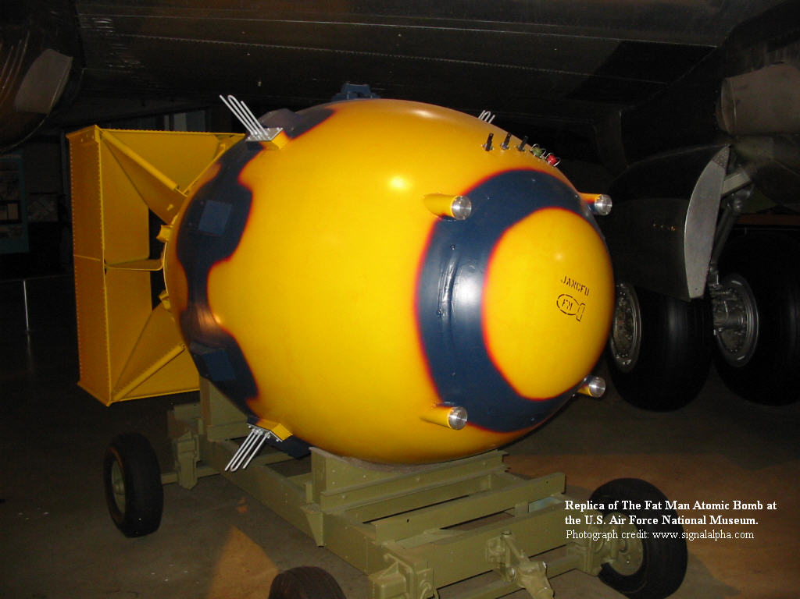
B29 Bock’s Car & the Plutonium Bomb called “Fat Man”

Slide 20
3 days later…Nagasaki
WATCH A VIDEO ON THE EVENTS OF THAT DAY

Slide 21
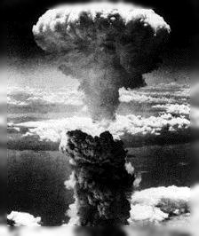
Nagasaki 11:02 am on August 9, 1945 as seen at the rear of the B-29 “Bock’s Car.” It had been a second choice target, the location of the Mitsubishi Aircraft factory that made the Japanese Zero fighter plane.

Slide 22
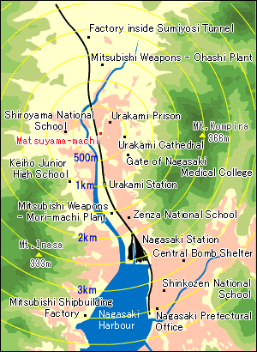
The bomb that was dropped on Nagasaki was said to have been about three times more powerful than the uranium bomb dropped on Hiroshima.
At the moment of the explosion there was a brilliant flash of light. Ten seconds later an enormous roar and a fearful blast swept across the area. Sharp rays of heat emitted massive amounts of radiation. Everything was incinerated.

Slide 23
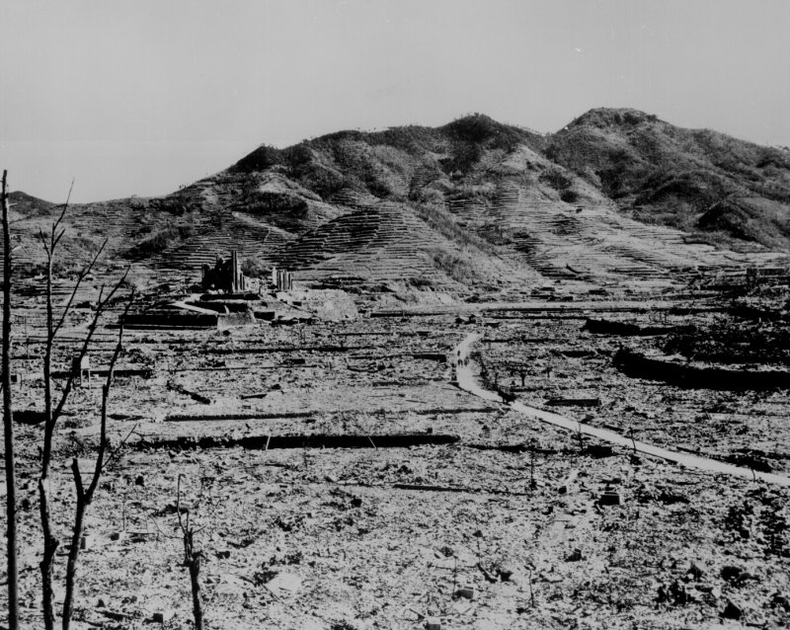
Nagasaki is in a valley. The bowl shape intensified the damage.

Slide 24
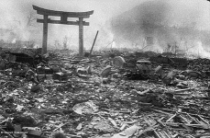
Smoking Ruins and a Tori gate.

Slide 25
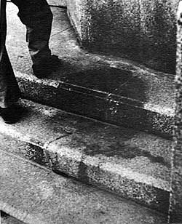
Only Shadows Remain…
The flash burns are all that is left of a person sitting at this column when the Nagasaki bomb went off.

Slide 26
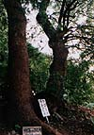
The atomic bomb reduced the Urakami area to ash, transfigured the landscape to the color of death, and incinerated the trees all the way to the tops of the surrounding hillsides.
It was initially estimated that nothing would grow again for 100 years, but it wasn't long before green sprouts were seen pushing their way up from the atomic wasteland. Some of the trees that were thought to have died began to shoot forth tender new leaves, renewing the hope of suffering Nagasaki people.
Twin Camphor Trees….Shiroyama Primary School

Slide 27
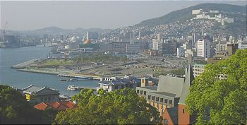
Nagasaki Today

Slide 28
Low-level amounts of radiation still exist in both modern cities . As the World War 2 generation dies, the memories of the terrible destruction dims. There were survivor benefits (medical care) awarded, but accepting them came with a shame for having lived when many friends & neighbors became “Kami” that day.
At least 75% of those who live in both Hiroshima and Nagasaki today have no direct connection and only know what they have been taught in school…
“The atomic bomb made the prospect of future war unendurable. It has led us up those last few steps to the mountain pass; and beyond there is a different country.” J. Robert Oppenheimer

Slide 29
Learn More about the Atomic Bombs…
Their affect on the Japanese and Our World …
View the two videos that follow…

Slide 30
DISCUSSION: WAS IT WRONG TO USE THE ATOMIC BOMB? View the argument presented by Father Miscamble – Notre Dame University 5 min. Running Time
https://www.youtube.com/watch?v=BmIBbcxseXM

Slide 31
Watch a Survivor account of Hiroshima
From the Newspaper – The Chugoku Shimbun
25 mins. Running Time
http://www.hiroshimapeacemedia.jp/?page_id=25648

Slide 32
Essential Question: What was the role of the United States in the rebuilding of Japan after WWII?
Standard: SS7H3c. Explain the role of the United States in the rebuilding of Japan after WWII.

Slide 33
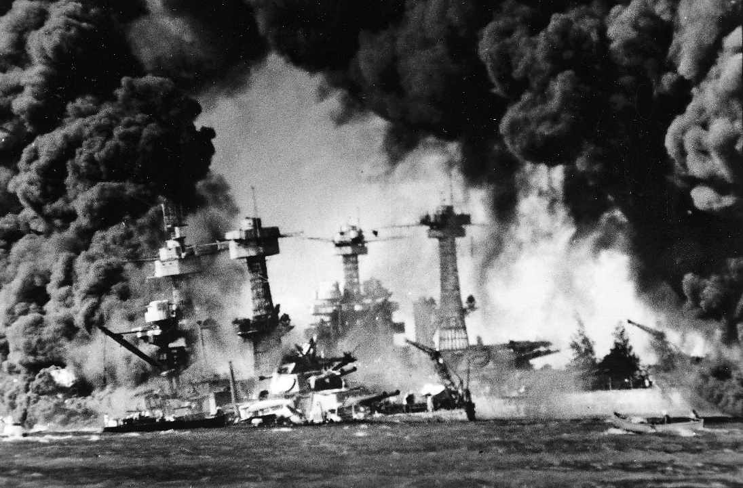
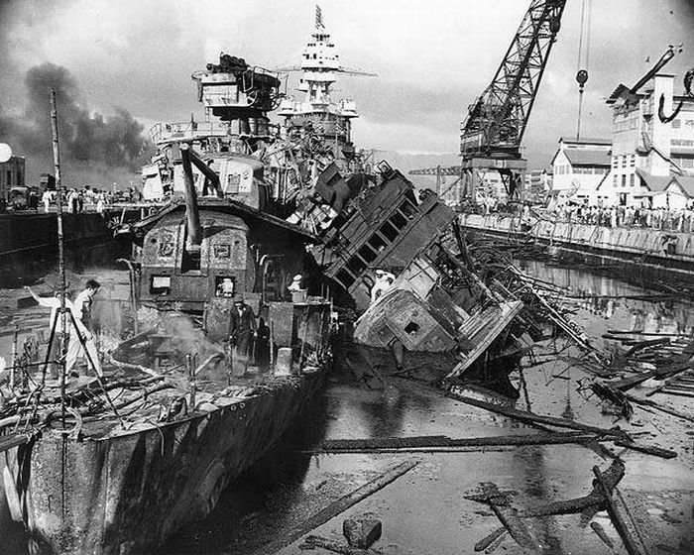
U.S. and Japan Interaction During World War II
Japanese fighter planes bombed the American military base in Pearl Harbor, Hawaii in 1941.

Slide 34
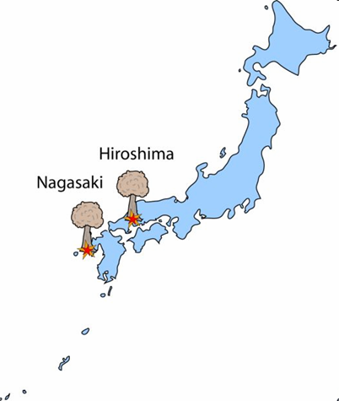
U.S. and Japan Interaction During World War II
After Pearl Harbor, the U.S. declared war on Japan. After years of fighting, the U.S. dropped two atomic bombs on two Japanese cities.

Slide 35
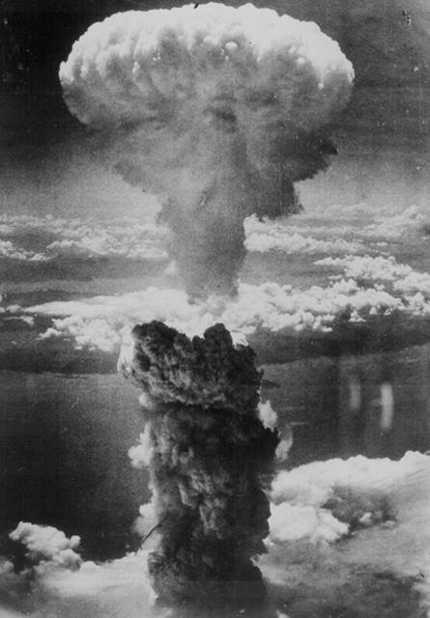
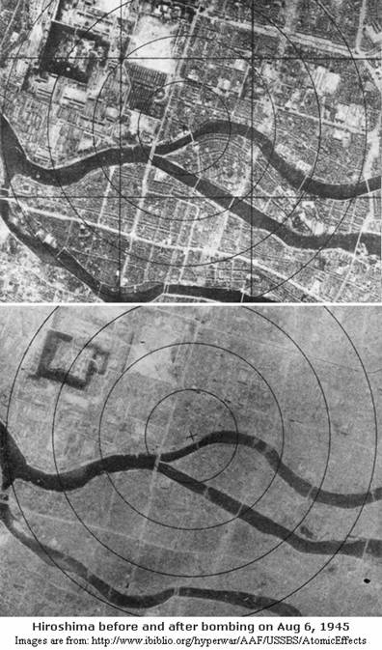

Slide 36
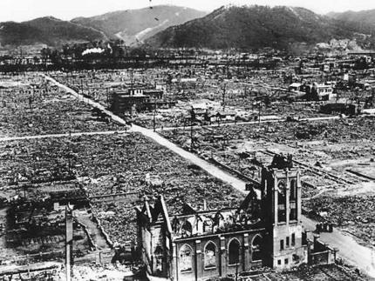
www.smh.com.au

Slide 37
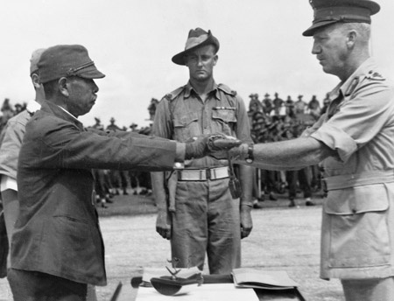
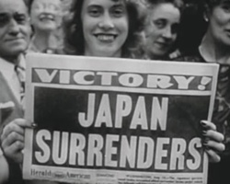
World War II ended in 1945 with the surrender of Japan. Japan’s economy and government were devastated.

Slide 38
In an effort to restore Japan to a thriving country, General Douglas MacArthur was sent as the Supreme Commander of the Allied Forces to oversee the rebuilding of Japan.
Why would the Allied Forces want to rebuild Japan after their aggression during the war?
Notes:
Remind students of what they learned about Germany after World War I (in 6th grade SS). Blaming Germany for the war and making them pay huge reparations is seen as one cause of World War II. The Allied Forces learned from their first mistake.

Slide 39
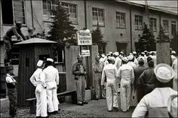
Rebuilding of Japan After World War II
The United States occupied the territory from 1945-1952.

Slide 40
Rebuilding of Japan After World War II
Japan’s military was disbanded and weapons factories were closed
Government and military leaders involved with military aggression and Japanese bombings during the war were brought to trial and punished.

Slide 41
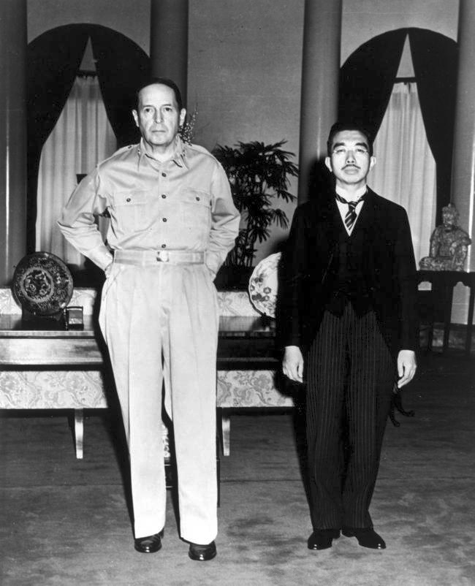
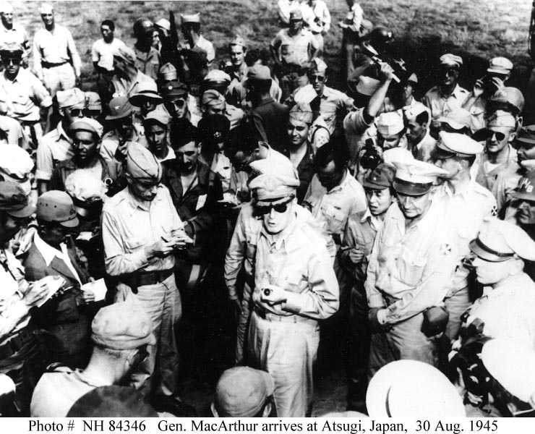
Rebuilding of Japan After World War II
General MacArthur helped Japan establish a constitutional monarchy and write a new constitution.

Slide 42
Constitutions of Japan Analysis

Slide 43
Reforms in Japan during Rebuilding
REFORMS
POLITICAL
ECONOMIC
SOCIAL
New
Constitution
Improve
Infrastructure
English as
2nd language
Constitutional
Monarchy
Market Economy
Japan adopts
US culture
Emperor Stripped
of Power
Invest in Human and
Capital Resources
Women’s
Suffrage

Slide 44
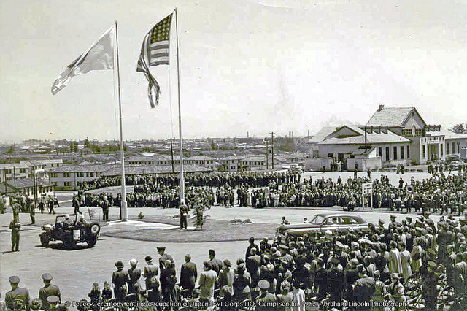
In 1952, power was transitioned back to the Japanese government.

Slide 45
Reasons for U.S. Involvement
Economic – The U.S. wanted Japan’s economy to get stronger so that it could become a market for U.S. products
Political – The U.S. wanted to stop the spread of communism in Asia (since China is so close) and promote democracy

Slide 46
The United States’ efforts to rebuild Japan after WWII were successful.
Japan now has one of the strongest economies in the world and a stable democratic government.

