Slide 1
Vocabulary Choice Board

Slide 2
Option A: Frayer “Circles” (more like, “Cards”…)
“18 vocabulary words, so 18 index cards!”
(FRONT)
Vocabulary Word
Illustration
You will need one index card per vocabulary word… your teacher has index cards (of various sizes, with/without lines). If you need them, just wait until your teacher calls on your group to gather individual supplies.
On the front of the index card, NEATLY (and with CLEAR effort and attention to detail)…
Write the vocabulary word.
Illustrate the vocabulary word (showing that you know what the word means).
MUST be artfully shaded OR colored neatly (SLOW DOWN, BE INTENTIONAL!)
On the back of the index card, NEATLY (and with CLEAR effort and attention to detail)…
Write the definition of the vocabulary word.
Use the vocabulary word in a sentence OR thoughtful/creative/clever hashtag that proves you understand what it means.
Write a synonym (a word/phrase that means the same thing) of the vocabulary word.
Write an antonym (a word/phrase that means the opposite) of the vocabulary word.
wealth
(BACK)
Definition:
An abundance (a lot) of goods, resources, or money
Sentence OR Hashtag
Saudi Arabia has a wealth of petroleum that they sell to countries all over the world, including the United States.
Synonym: rich (wealthy)
Antonym: poverty-stricken; poor

Slide 3
Option B: Create an acrostic with each vocabulary word.
For each word, NEATLY write the word vertically (like the y-axis) in all capital letters. See ACROSTIC to the left.
Think about what the word means and how to include it in a sentence.
Use the capital letters to start each line of a sentence, sentences, poem, rhyme, etc. that shows you KNOW the meaning of the word in context (the real world).
Make it thoughtful/creative/clever/funny… Just make sure it makes sense and satisfies #3 (above).
A word that Can be spelled so that it Reads from top to bottom Or across, as a poem. Sometimes it is very clever. That's an acrostic poem. It can also refer to a puzzle. Cool. Isn't it?
“Fancier” Fonts…
(For more points, try changing up your lettering, your handwriting.)
Like this OR THIS OR THIS
OR THIS OR THIS OR THIS OR THIS OR THIS OR THIS
OR THIS OR THIS OR THIS…

Slide 4
Option C: Picture book: Create a Picture book with each of the vocabulary words.
WARNING! Do NOT select this option if you are not a visual artist… your picture quality is part of your grade.
AVAILABLE SUPPLIES FOR “BOOK MAKING”
Copy paper
Blank 5x8 index cards
Construction paper (various colors)
Scissors
Stapler + staples
Hole-puncher
Rulers
Colored pencils
Markers
“18 vocabulary words, so
18 pages in my book + 1 Title Page + 1 cover… AHH! I need to think this through!”
“Fancier” Fonts…
(For more points, try changing up your lettering, your handwriting for the cover, Title Page, vocabulary words, etc.)
Like this OR THIS OR THIS OR THIS OR THIS
OR THIS OR THIS OR THIS OR THIS OR THIS
OR THIS OR THIS…
YOU MUST…
Be neat.
Write in straight lines or use a lined paper.
Make sure it can be CLEARLY read (handwriting).
Use precise folding, cutting, and stapling when creating your book.
Use illustrations with artful shading OR colored neatly (SLOW DOWN, BE INTENTIONAL!)
Be creative, thoughtful, clever, funny with your “stories” and illustrations… (just be sure to apply the vocabulary correctly.)
Show effort and pay attention to the details.
Plan which supplies (and how much of each) you will require to create your book.
Gather supplies for “book making” by waiting for the teacher to give your group permission to retrieve your own supplies.
Build your book with gathered supplies.
Include:
Illustrated/fancifully-lettered cover
Title Page with book’s name, author, and copyright year (©2021)
A dedication page (Write a thankful note to your inspiration for the book.)
A page for EACH of the vocabulary words, including:
The word used in a sentence/sentences that show you KNOW what the word means in context (the real world)
An illustration of what is happening in your sentence/sentences/short paragraph (caption)
A page number

Slide 5
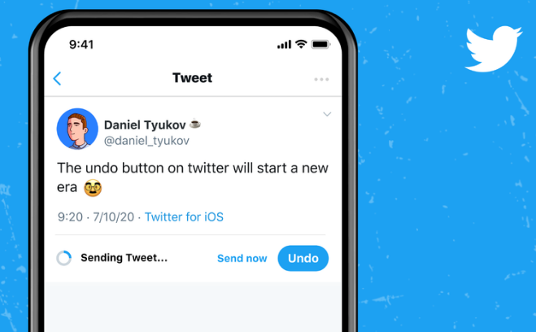
Option D: Twitter post: Write a tweet, post a pic, and create a username for each vocabulary word, as if it were a Twitter user.
You will need one index card per vocabulary word… your teacher has index cards (of various sizes, with/without lines). If you need them, just wait until your teacher calls on your group to gather individual supplies.
Include on each card – ALL should be creative, clever, and unique, and ALL should show you KNOW what the word means in context (the real world).
Real Name
Twitter name/username
Twitter picture (your illustration to represent who the vocabulary word is… neat, huh?)
Tweet (Written from the perspective of the [personified] vocabulary word)
2 Hashtags
*Include Mention, Web link, or a Reply for more points! (If you understand these components, go for it! If not, look it up using your device, AFTER you obtain permission.)
“18 vocabulary words, so 18 index cards!”
YOU MUST…
Be neat.
Write in straight lines or use a lined index card.
Make sure it can be CLEARLY read (handwriting).
Use illustrations with artful shading OR colored neatly (SLOW DOWN, BE INTENTIONAL!)
Be creative, thoughtful, clever, funny with your Tweet components… (just be sure to apply the vocabulary correctly.)
Show effort and pay attention to the details.

Slide 6
Option E: Create a Q/A game using the vocabulary words
NOT YET AN OPTION
COMING SOON
to a
Choice Board
near you…
This Photo by Unknown Author is licensed under CC BY-NC-ND

