Slide 1
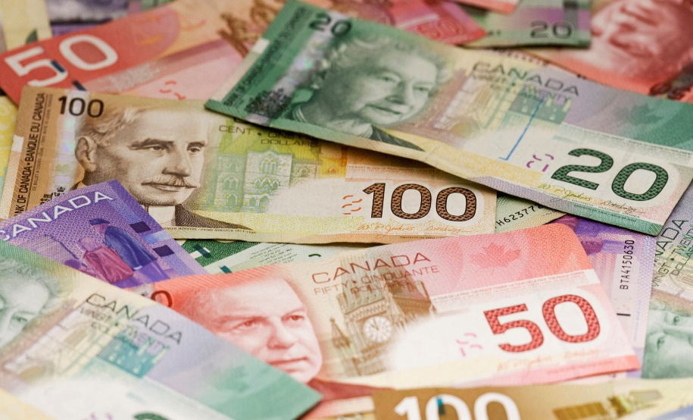
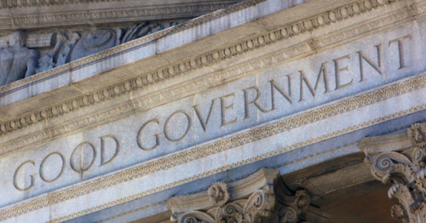
Economics & Government Vocabulary

Slide 2
Human Resources/Capital
The knowledge and skills (education) that allow workers to produce goods and services and earn a salary.
Example: The knowledge and skills needed to become a doctor, lawyer, teacher, or car mechanic.

Slide 3
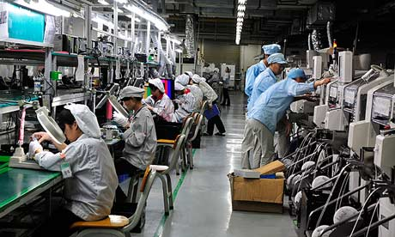
Capital Resources
Goods such as factories, machines, and tools that workers use to make other goods.

Slide 4
Entrepreneurship
People who have these qualities risk their time, money, and energy to make a profit.
They might create new products, come up with new ways to make things, or find new ways to reach buyers (ex. iTunes, Facebook).

Slide 5
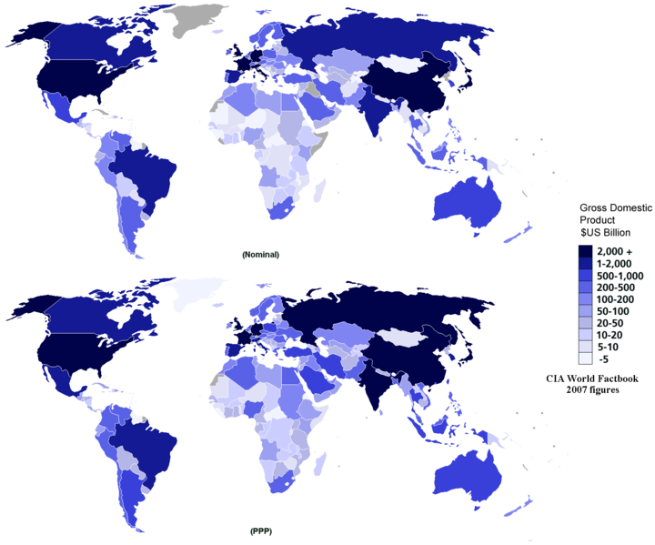
Gross Domestic Product (GDP)
The total value of all goods and services produced in a country every year.

Slide 6
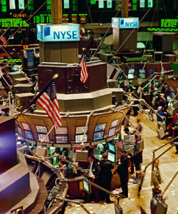
Invest (Investment)
To buy more of something in order to benefit from it in the future.
Examples:
Stocks (Stock Market)
Putting money (capital) into a business or company

Slide 7
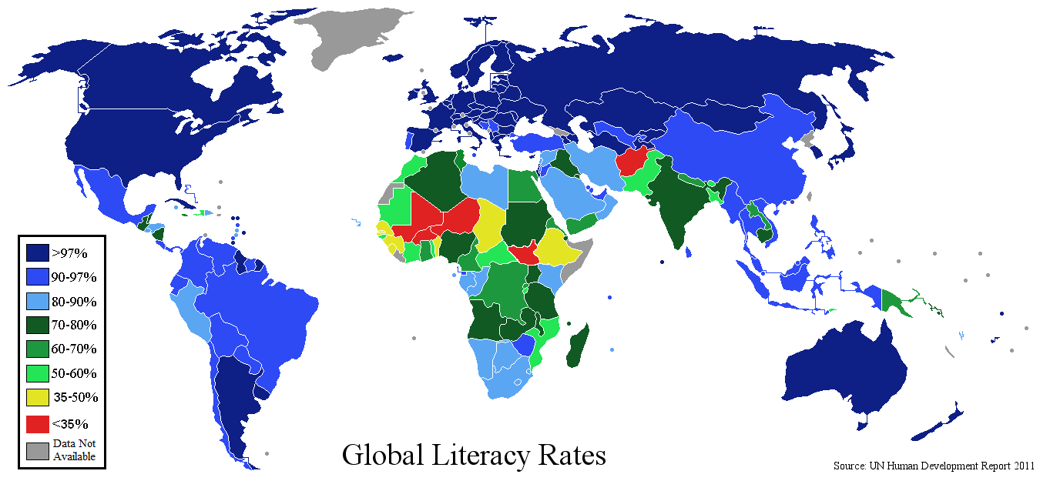
Literacy Rate
The percentage of people who can read and write in a country.
Literacy Rate is usually tied to the country’s GDP (higher literacy rate usually means the country will have a higher GDP).

Slide 8
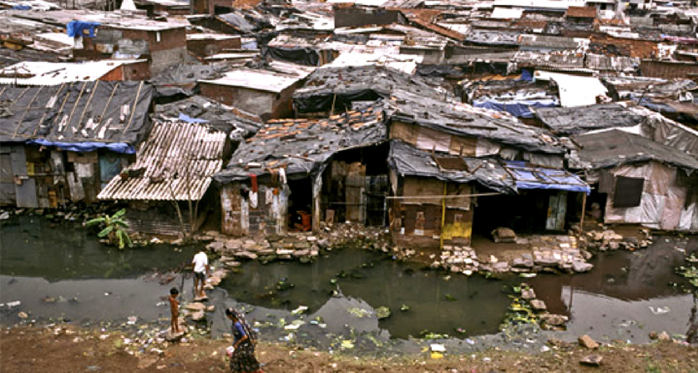
Standard of Living
A person’s level of comfort.
Determined by the amount of goods, services, and luxuries available to a person.
Countries with a higher GDP usually have a higher standard of living.

Slide 9
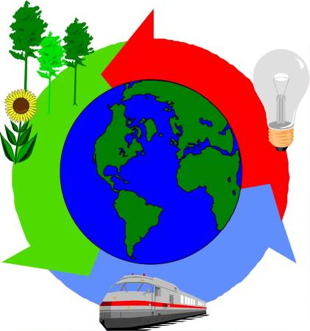
Economic System
The way a nation uses its resources to satisfy people’s needs and wants.
There are 3 major economic questions that the systems answer:
What to produce?
How to produce?
For whom to produce?
Although there are 3 major economic systems, most countries are Mixed Economies.

Slide 10
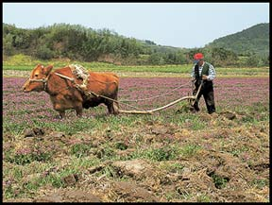
Traditional Economy
An economic system in which social roles and culture decide what goods and services will be produced, how they will be produced, and for whom
People do things the way they always have (following the traditions of their people).

Slide 11
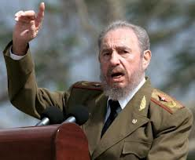
Command Economy
An economic system in which the government decides what goods and services will be produced, how they will be produced, and for whom.
The government has the power to control the economy and command the people to do what the government says.

Slide 12
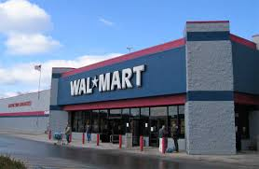
Market Economy
An economic system in which individual choices decide what goods and services will be produced, how they will be produced, and for whom.
This is commonly referred to as a Free Market system, because people have the freedom to do what they want.

Slide 13
Mixed Economy
An economic system that has mixed features of traditional, command, and market systems.
Most countries are Mixed Economies, falling on a continuum somewhere between a Command (0% Free) and Market Economy (100% Free).
0
Pure Command
50
Mixed Economy
100
Pure Market

Slide 14
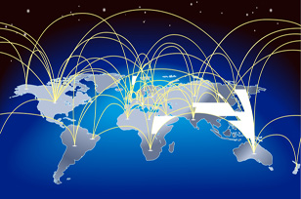
International Trade
The exchange of goods and services between countries.
International means between two or more nations (countries).

Slide 15
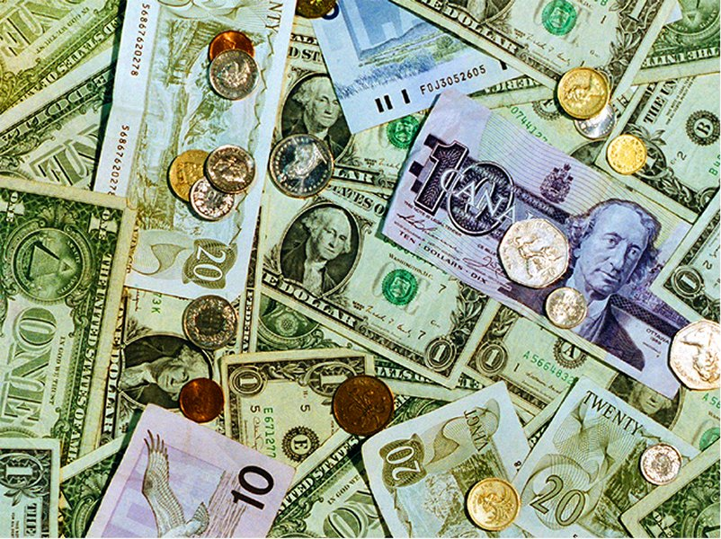
Currency
Money that is used as a way to trade goods and services;
Examples:
Paper Bills
Coins

Slide 17
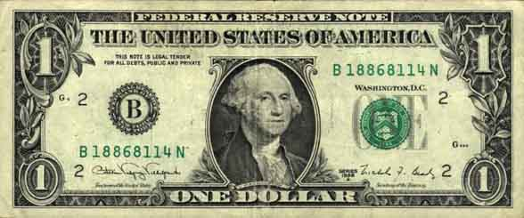
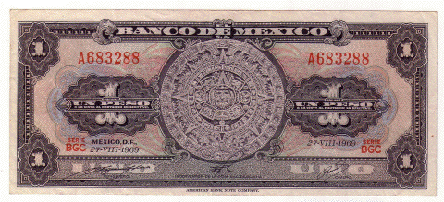
Exchange Rate
How much one country’s money is worth compared to another country’s.
Example:
16.49 Mexican Pesos = 1 U.S. Dollar (2015).

Slide 18
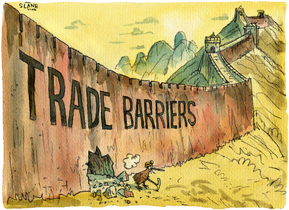
Trade Barrier
Any law or practice that a government uses to limit trade between countries.
This could be in the form of taxes (tariffs), quotas, or embargos.

Slide 19
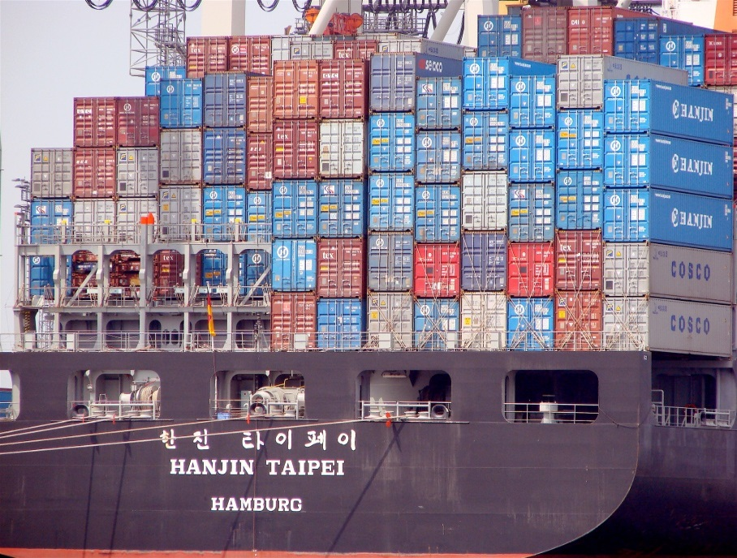
Tariff
A price or tax charged for goods or services brought into one area from another area.

Slide 20
Quota
A limit on the amount of product that may be imported during a given period of time.
Only a certain number of items can be imported.

Slide 21
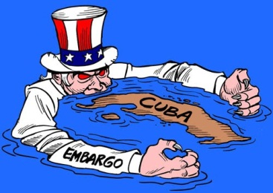
Embargo
When a country refuses to import or export certain goods; often backed by military force.
Example:
The United States has had an embargo against Cuba since October of 1960.

Slide 22
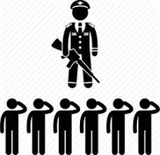
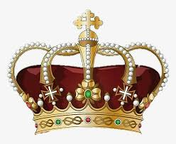
Autocracy
…is a country or nation that is governed by a single person with unlimited power.
Two types of autocracies: Absolute monarchy (hereditary) and Dictatorship (usually taken by force).

Slide 23
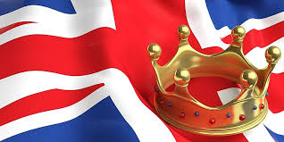
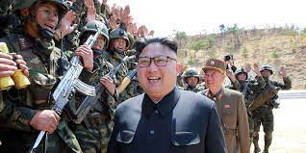
Monarchy
…is a government ruled by someone who usually inherits the authority.
Two types: Constitutional (limited power for monarch) and Absolute (unlimited power for the monarch).
Examples: Britain = Constitutional Monarchy & North Korea = Absolute Monarchy

Slide 24
Constitutional Monarchy
…gives limited powers to the monarch (king, queen, emperor, etc.).
The monarch has to follow the laws set out in the Constitution.
Often countries have a Constitutional monarch and a legislature (like Parliament).
Often Constitutional monarchs are just figure-heads, a celebrity/”mascot” with no real governmental power.

Slide 25
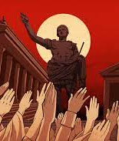
Dictatorship
…is a type of autocracy (country or nation governed by a single leader with unlimited power).
Dictators often dethrone/overthrow leaders to take power.
Sometimes associated with popularity among the military/a regime.

Slide 26
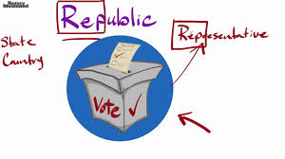
Republic
…is a government in which the people elect representatives to make the laws.
Republic = representatives
All democracies are republics. (We all vote for our leaders, that do the voting for us.)

Slide 27
Democracy
…is a government that receives its power from the people.
Citizens (meeting certain criteria) participate by voting for their representative leaders (usually in the Executive and Legislative branches).
Two types: Presidential and Parliamentary democracies.

Slide 28
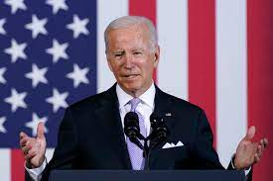
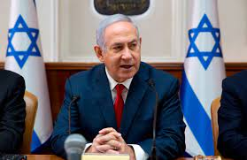
President/Prime Minister
Two titles naming the executive leader in a Parliamentary and Presidential Democracy.
They are the “public face of the democracy”, kind of like the “mascot of the democracy” as the Head of State, the Head of Government, or both.
Presidents typically lead Presidential Democracies, where Prime Ministers lead Parliamentary Democracies.

Slide 29
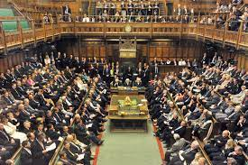
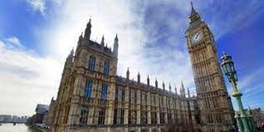
Parliament
A legislative body (legislature) that is responsible for writing/making laws.
…is elected by eligible citizens.
In a Parliamentary democracy, the Executive leader is selected from among parliament members.

Slide 30
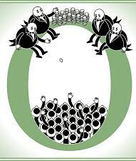
Oligarchy
…is a government controlled by a small group of people.
Often the “small group” has wealth, privileges, and connections to those in power.
Often the “small group” is appointed, not elected.

Slide 31
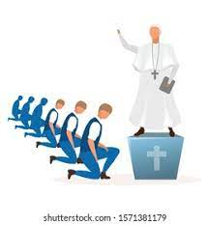
Theocracy
…is a government ruled by a religious leader or leaders.
They adhere to the laws prescribed by their religion/religious text.
Examples: Iran, Vatican City

